Slide 1
COVID-19 Policies
May 4, 2020

Slide 2
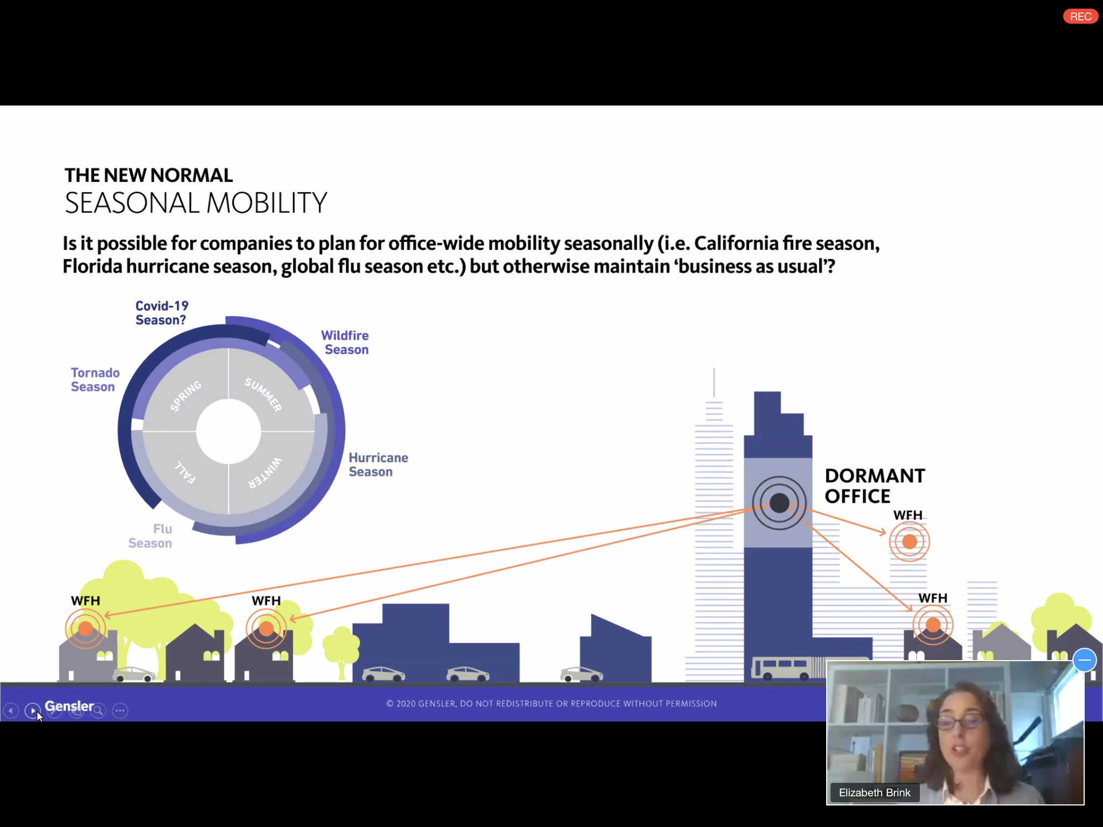
Seasonal Mobility – The New Normal

Slide 3
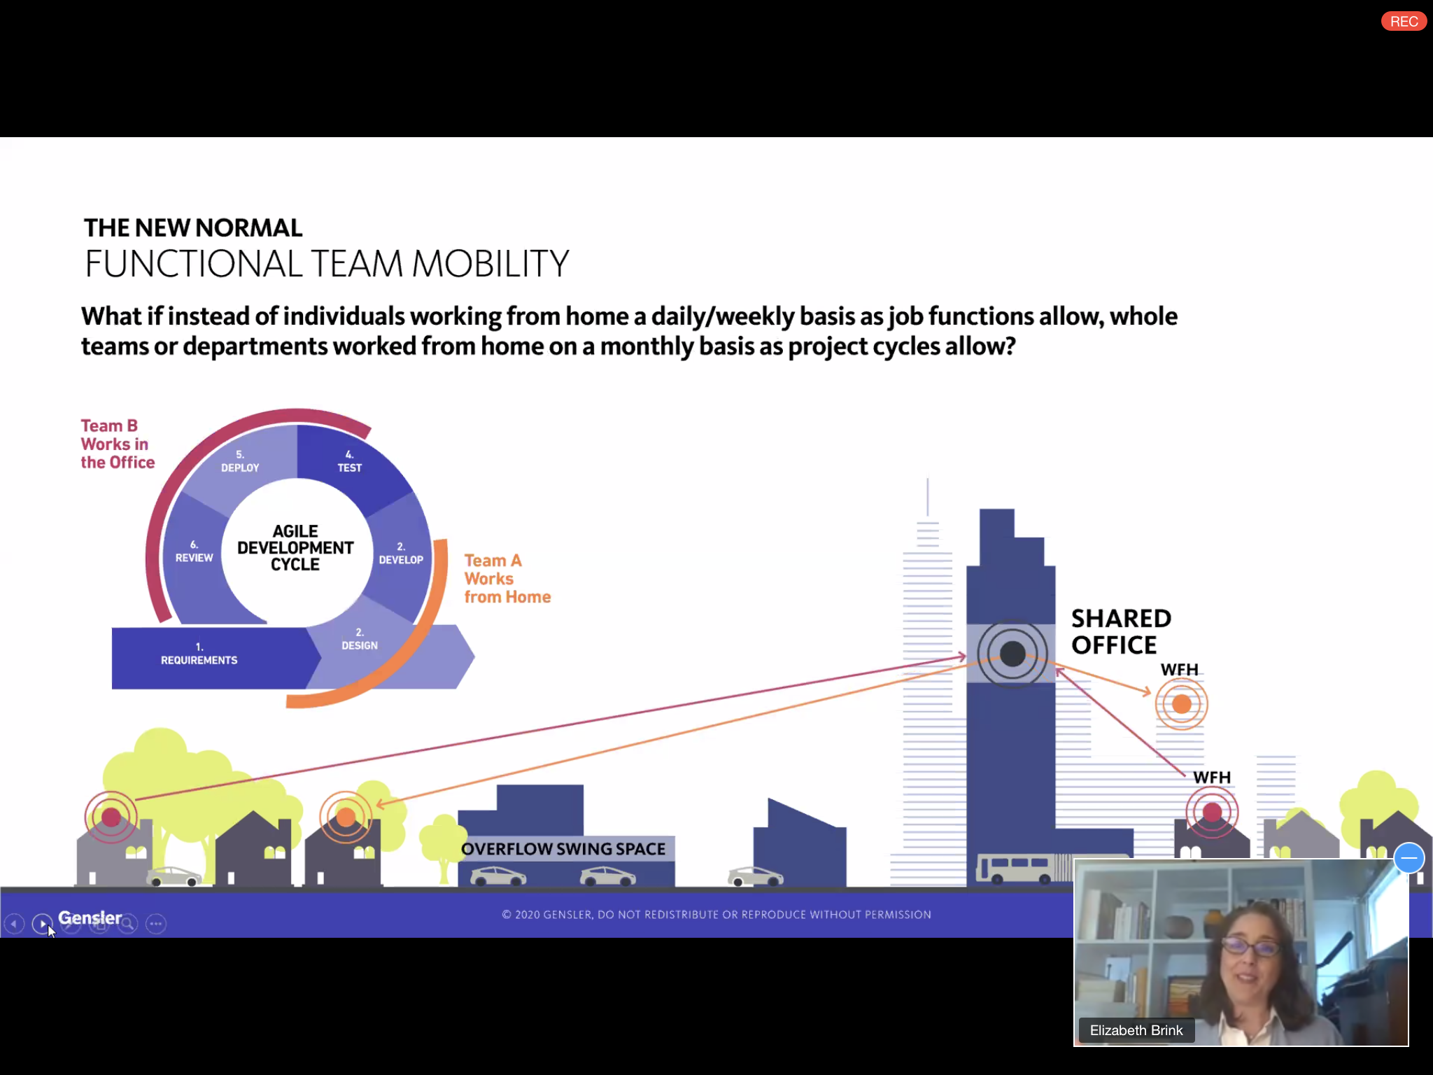
Functional Team Mobility

Slide 4
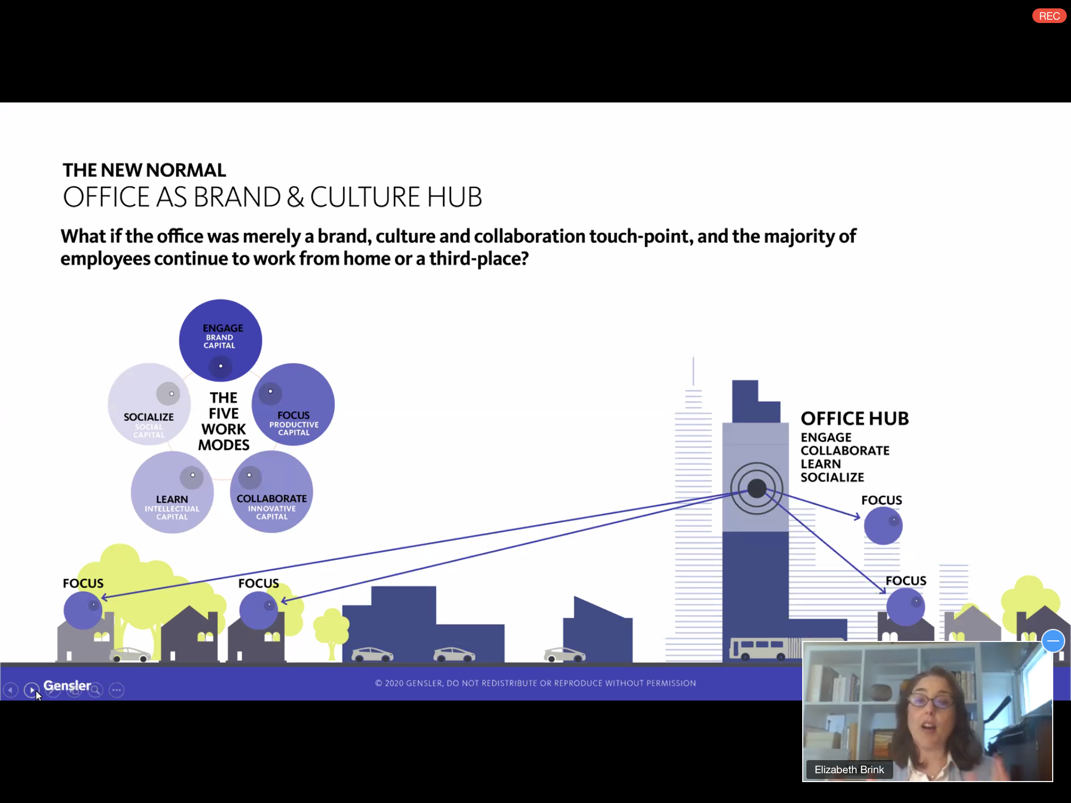
Office as Brand & Culture Hub

Slide 5
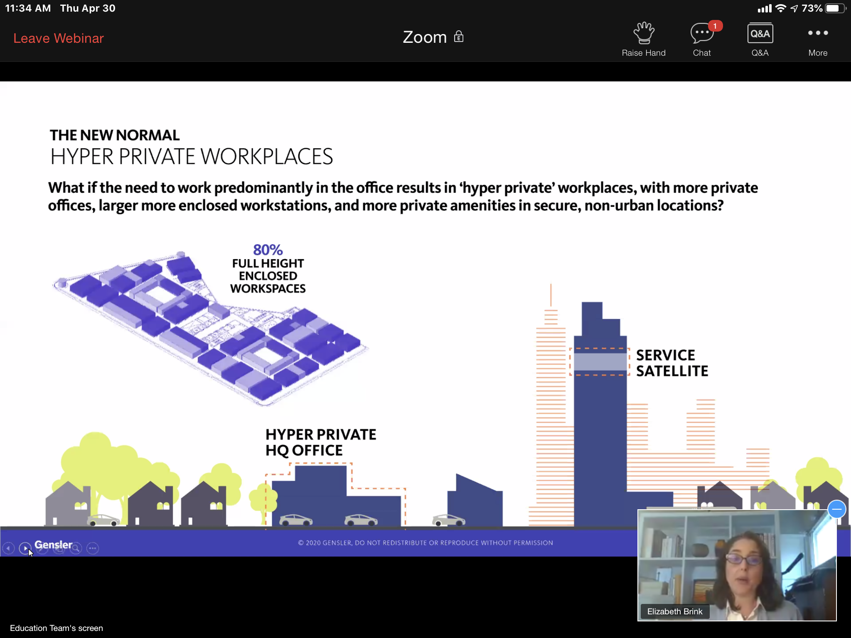
Hyper Private Workplaces

Slide 6
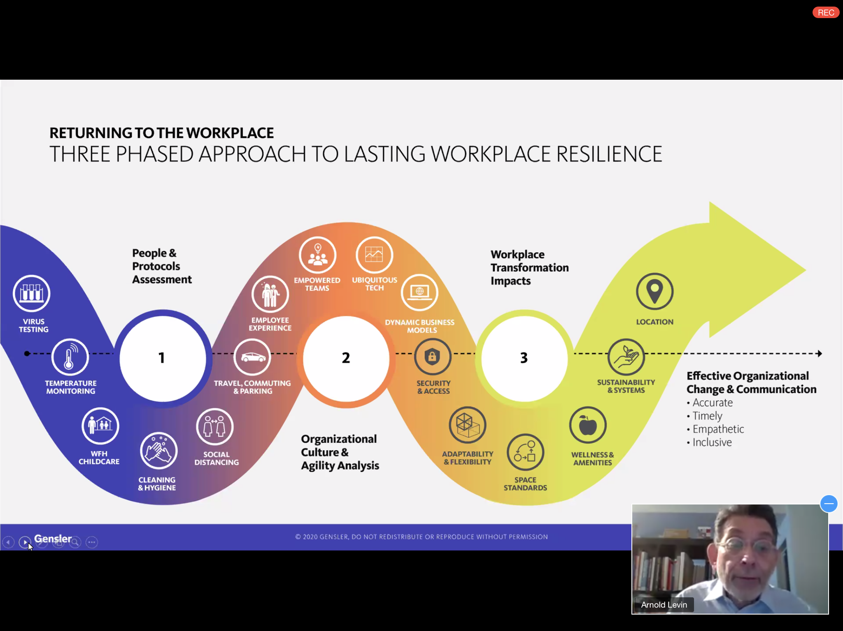
Three Phased Approach to Lasting Workplace Resilience

